Slide 1


Group-12
HUMAN ACTIVITY RECOGNITION (HAR)
Aadhijith.E.G - CB.SC.U4AIE24113
Kamalesh.A.L - CB.SC.U4AIE24121
Siva Adithya - CB.SC.U4AIE24126
Siddarth Sankar - CB.SC.U4AIE24151
Presented by

Slide 2



INTRODUCTION
Human Activity Recognition (HAR) is an emerging field in artificial intelligence that focuses on identifying and classifying human movements using data from sensors or videos. It plays a significant role in various applications .
Our project aims to develop an efficient system that can accurately recognize different human activities based on input data.

Slide 3

DEEP LEARNING TECHNIQUES
LSTM
CNN

Slide 4

1. CONVOLUTIONAL NEURAL NETWORKS (CNN)
CNN is used to extract spatial features from input data (such as images or sensor data).
It identifies patterns and key features, making it ideal for recognizing human activities from video frames or sensor signals.
2. LONG SHORT-TERM MEMORY (LSTM)
LSTM is a type of recurrent neural network (RNN) that specializes in handling sequential data.
It captures temporal dependencies in human movements, making it crucial for analyzing continuous activities over time.

Slide 5
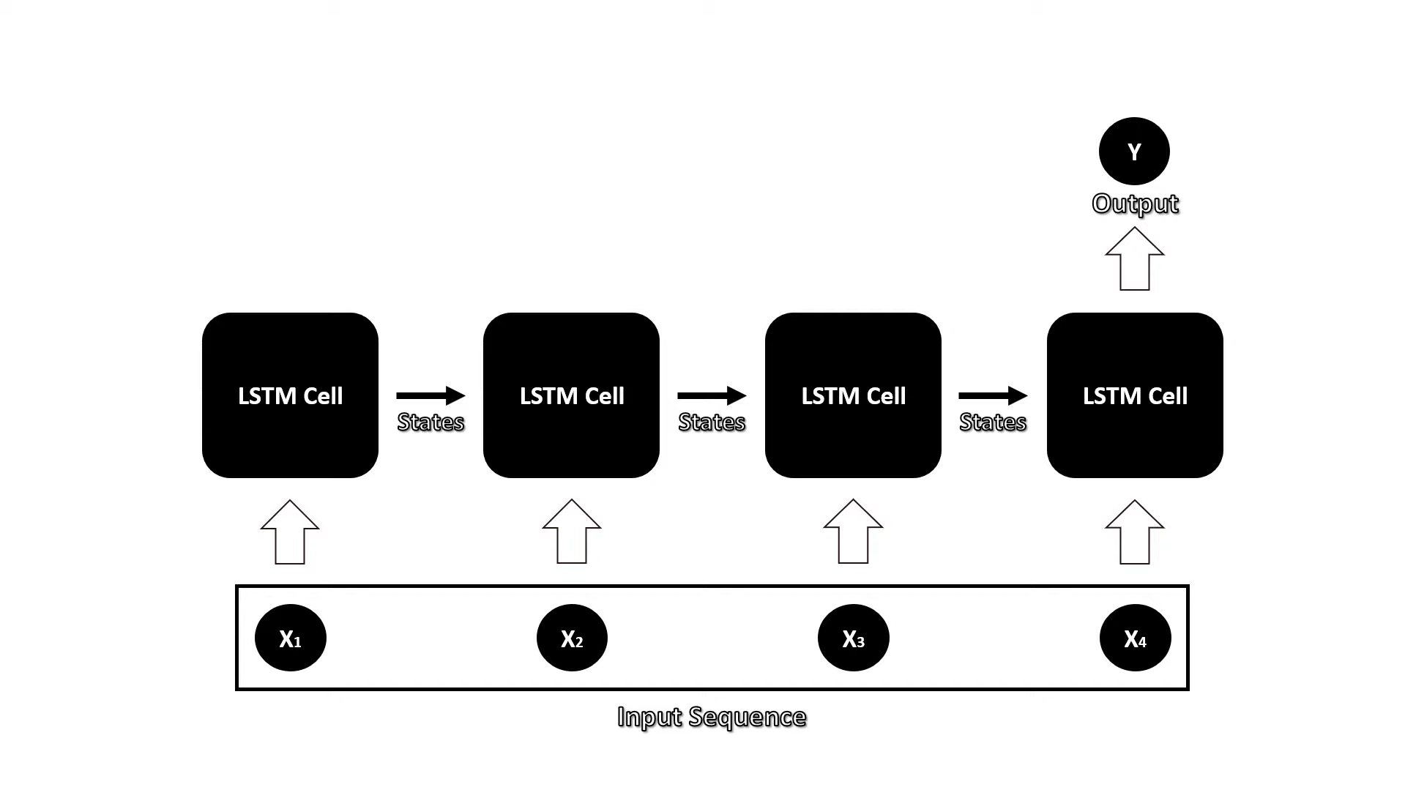
LSTM MODEL

Slide 6
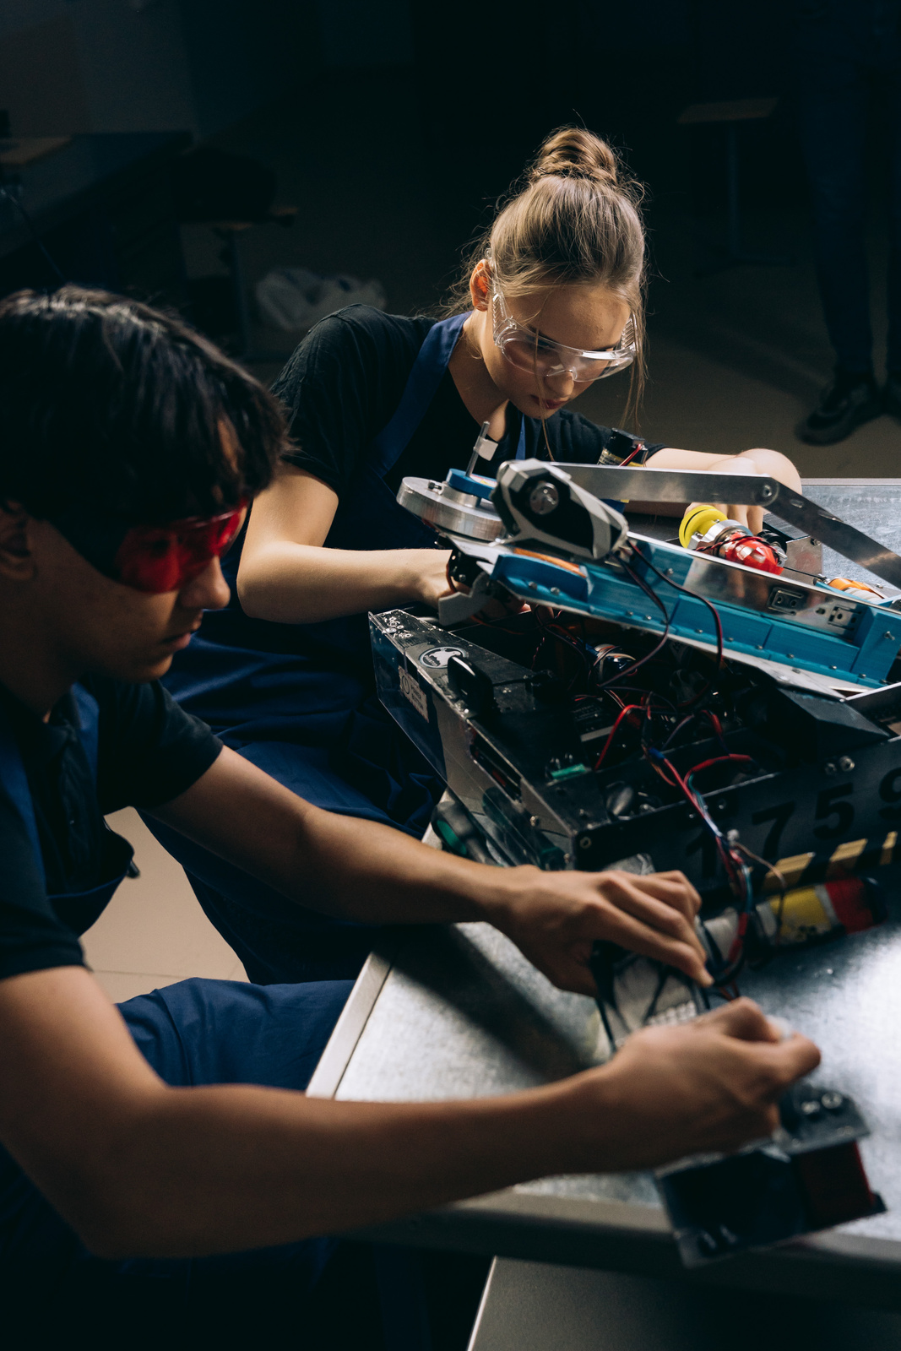

OBJECTIVE
The objective of this project is to develop an efficient Human Activity Recognition (HAR) system that accurately identifies and classifies various human activities using the Video provided of the activity
The system aims to leverage deep learning techniques to analyze features from video sequences, ensuring activity recognition.

Slide 7


CODE FOR HAR
click here to open the code in jupyter
Understanding How the Code work ?
Data Loading: Videos are read, resized to 64x64, and divided into 20-frame sequences for processing.
Model Architecture: A CNN-LSTM model extracts spatial features and captures temporal dependencies for activity recognition.
Training Process: The model is trained using the Adam optimizer, with EarlyStopping and a Learning Rate Scheduler to improve performance.
Evaluation: Accuracy and loss graphs are plotted to monitor both training and validation performance.
Result Analysis: The model achieves ~90% training accuracy and ~75% validation accuracy, with slight overfitting signs.

Slide 8
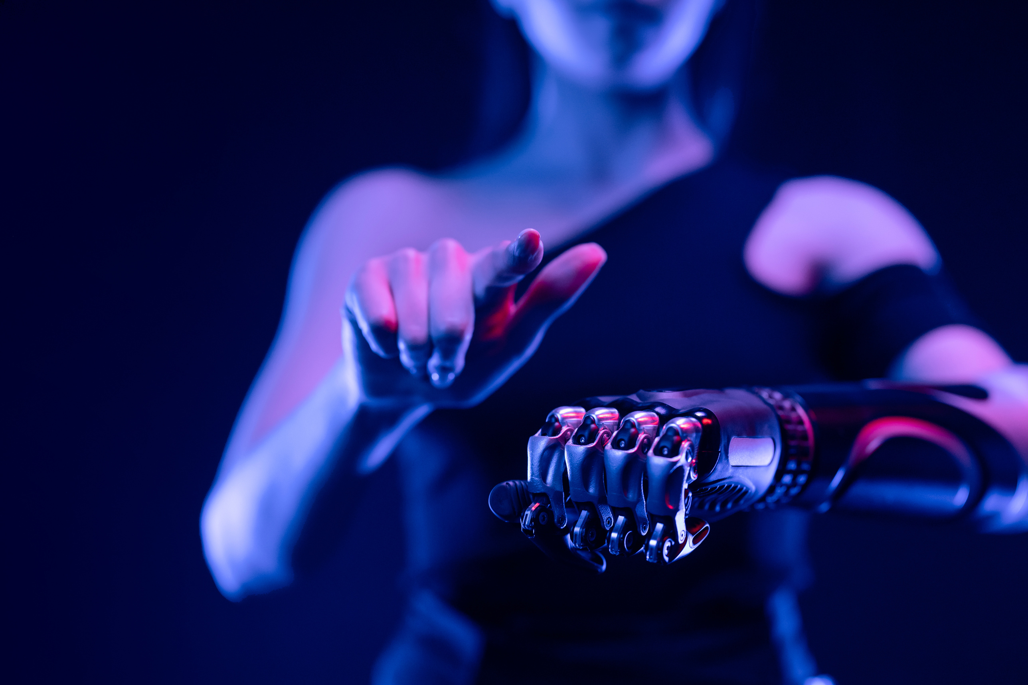

METHODOLOGY
Data Collection and Loading
The code utilizes the UCF50 dataset, a popular video dataset for human activity recognition.
Videos are read using cv2 (OpenCV), resized to a defined resolution, and processed as sequences of frames.
Data Preprocessing
Frames are resized to 64x64 for efficient processing.
Each video is split into 20-frame sequences to maintain temporal context.
Data augmentation may be included to improve model generalization.
Model Design
The model leverages a CNN-LSTM architecture:
CNN extracts spatial features from individual frames.
LSTM captures temporal dependencies across video frames.

Slide 9


The model layers include:
Conv2D layers for feature extraction.
MaxPooling2D for down-sampling.
LSTM layers for sequential data learning.
Dropout layers for regularization.
Dense layers for classification.
4.Training Strategy
A fixed seed (seed_constant = 27) ensures reproducibility.
The dataset is split into training and validation sets.
EarlyStopping is implemented to prevent overfitting.
5.Evaluation
The model's performance is measured using accuracy.

Slide 10


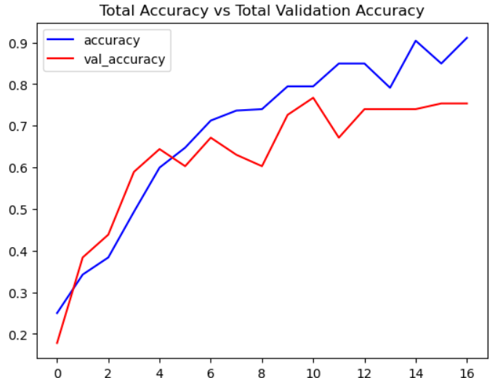

RESULTS
Training Accuracy:
The training accuracy steadily increases, reaching around 90% by the final epoch.
This indicates the model is learning well during training.
Validation Accuracy:
The validation accuracy improves consistently but plateaus around 75% after epoch 12.
The gap between training and validation accuracy suggests a slight overfitting issue — the model performs better on the training data than on unseen data.

Slide 11
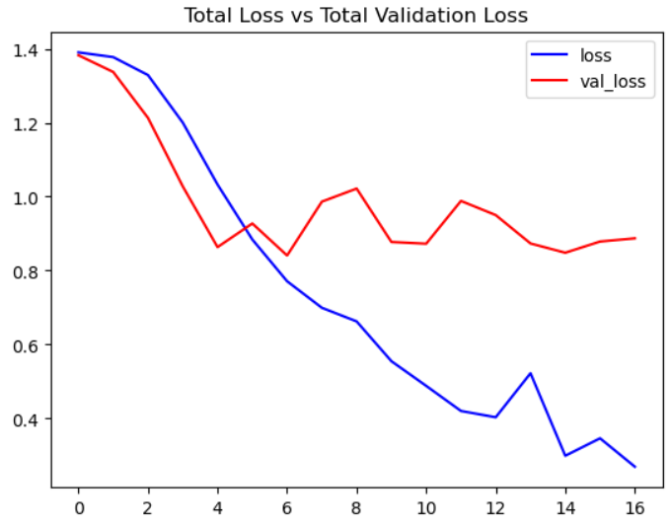

RESULTS
Training Loss:
The training loss shows a steady decline, which is ideal for a well-learning model.
Validation Loss:
The validation loss decreases initially but starts to fluctuate after epoch 6 and stabilizes later, which again hints at possible overfitting.

Slide 12

THANK YOU

